Slide 1



National Suicide Prevention Strategy 2025–2035
Community Toolkit

Slide 2

Acknowledgement of Country
Amend to suit the country you are meeting on
We acknowledge Aboriginal and Torres Strait Islander peoples as the Traditional Custodians of the lands and waters on which we live, work and learn.

Slide 3

Recognition of Lived Experience
We recognise the individual and collective contributions of those with lived and living experience of suicide. This includes people who have survived suicide attempts, cared for a person in suicidal crisis, or have lost a loved one to suicide. Every person’s journey is unique and valued.

Slide 4


Introductions
Amend prompt questions if needed
What is your name?
Is there anything you would like
people to know about you?
What are you most looking forward to getting out of the conversation today?
What is one word that best describes how you are feeling right now?

Slide 5

Help Seeking Support
If you or someone you know is experiencing suicidal distress, there are a number of resources available to help. An attachment to the meeting papers includes information about support and resources you can access for yourself or to support someone you know.
Support service 1
Support service 2
Suggest listing two support sources on screen here
e.g. Lifeline and one that is relevant to context
During today’s session, there is also a designated support person.
[Name of person] is available in real time if you would like to chat.
Optional addition of having designated support person available throughout the session.

Slide 6
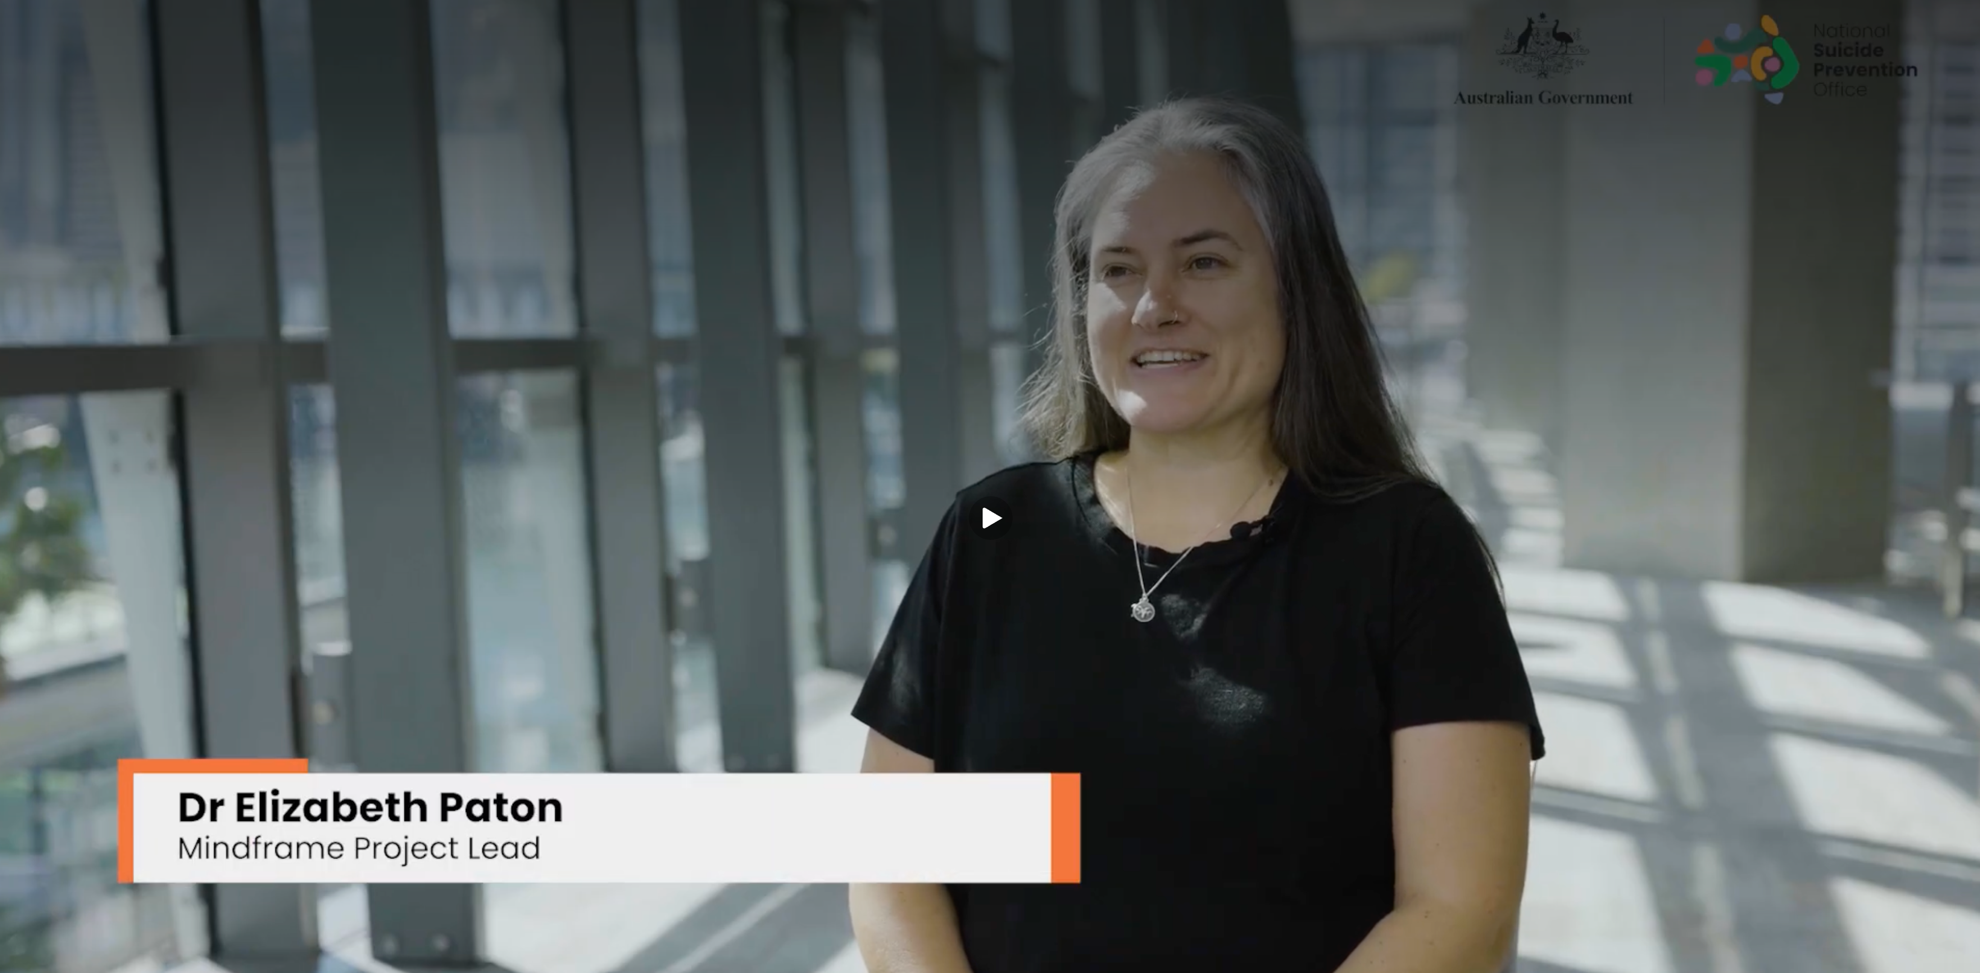



Safe Language – Elizabeth Paton

Slide 7

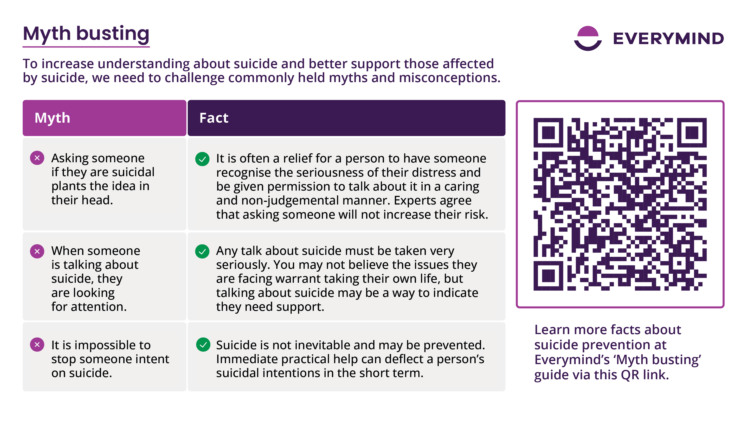
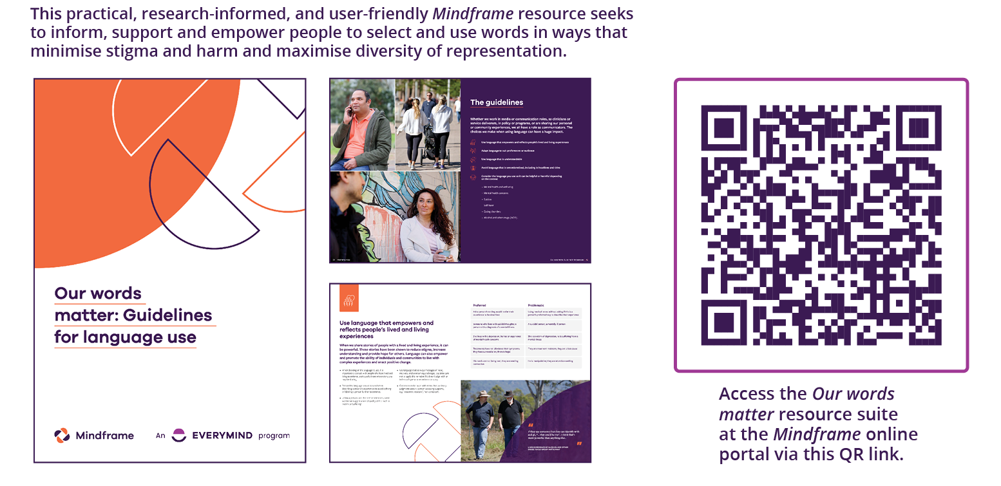
Our words matter: Guidelines for language use

Slide 8
Agenda
Insert copy of agenda here, an agenda template is available in pre session resources
Add agenda here

Slide 9


Housekeeping
Insert any need-to-know information here
Add text here

Slide 10

Outline roles
Note who they are and where they are in the room
Facilitator
Minute-taker
Timekeeper
Support person

Slide 11
Respectful engagement
Insert questions or prompts here to inspire reflection on respectful engagement
Add text here

Slide 12
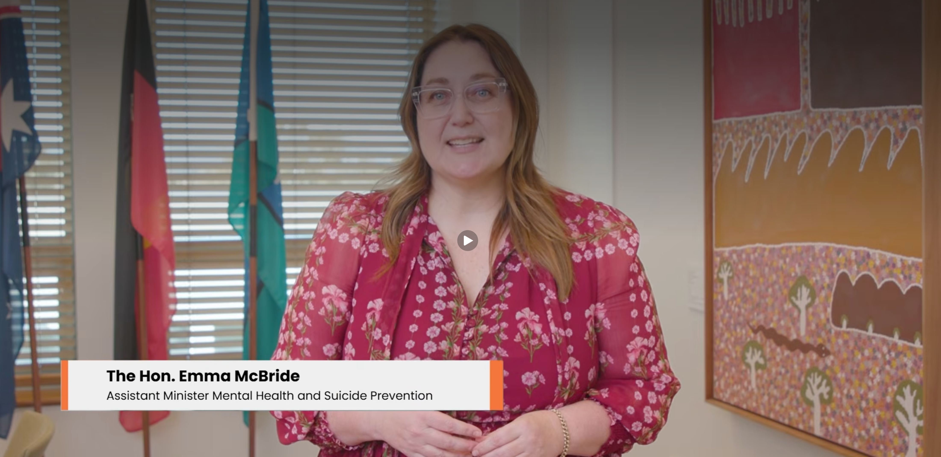
Introduction – Assistant Minister Emma McBride

Slide 13
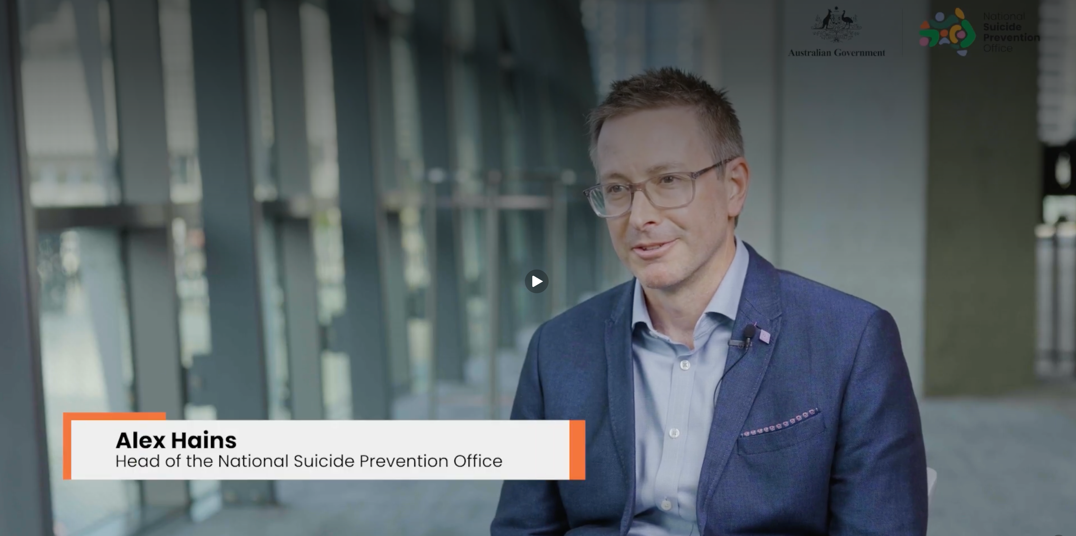
Purpose

Slide 14
Understanding suicide
Suicidal distress is a human response to overwhelming suffering. It is complex – typically, there are many factors at play rather than a single isolated cause.
These factors include social determinants (such as income, education, employment, housing, early childhood development, social inclusion and access to health care) and individual factors, including contextual factors (such as stressful life events, trauma, abuse and discrimination), clinical factors (for example, mental illness, drug and alcohol use, chronic physical illness), personality factors, genetic factors and demographic factors (such as age, gender, sexual orientation, ethnicity, cultural heritage).
It is often the impact of social determinants interacting with a person’s individual risk factors that lead to a person experiencing suicidal distress, as depicted in Figure 1.
Figure 1: Social determinants and individual risk factors for suicide and self-harm
Social determinants
Income and social protection
Employment and job security
Working life conditions
Housing and basic amenities
Structural equality
Education
Early childhood development
Environment
Social inclusion and non-discrimination
Access to quality healthcare
Individual risk factors
Contextual factors
(e.g. stressful life events and transitions, exposure to suicide, access to means, lack of family supports, trauma including intergenerational trauma, interpersonal violence, child abuse and neglect)
Demographic factors
(e.g. age, sex, gender, sexual orientation, ethnicity, cultural heritage)
Clinical factors
(e.g. mental illness, drug and alcohol use, gambling, history of self-harm, chronic
physical illness)
Personality factors
(e.g. impulsivity, coping style, impressionability)
Genetic, familial and neurobiological factors
(e.g.) family history of suicide, DNA
methylation)
Self-harm
Suicide

Slide 15
Myth busting

Slide 16
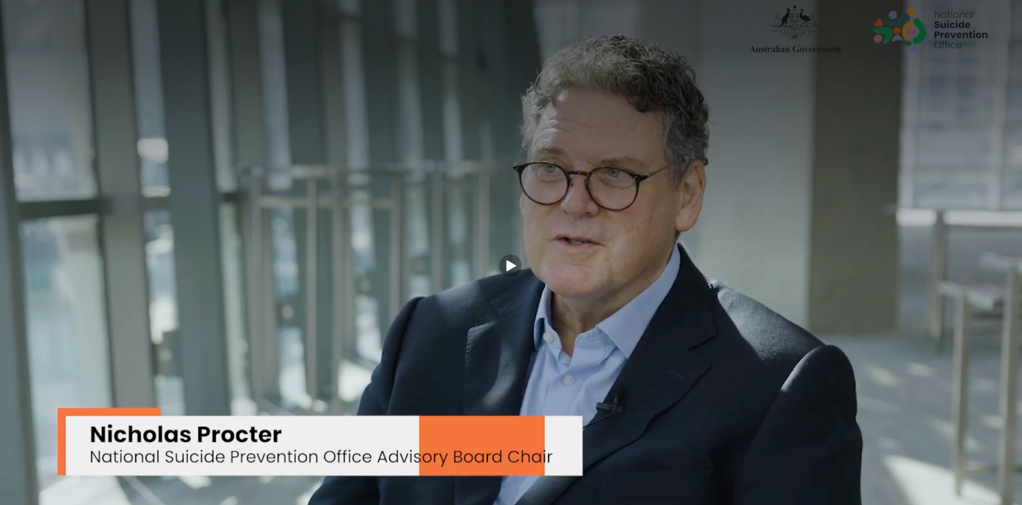

The Strategy

Slide 17

The Strategy and Outcomes Framework – animation

Slide 18
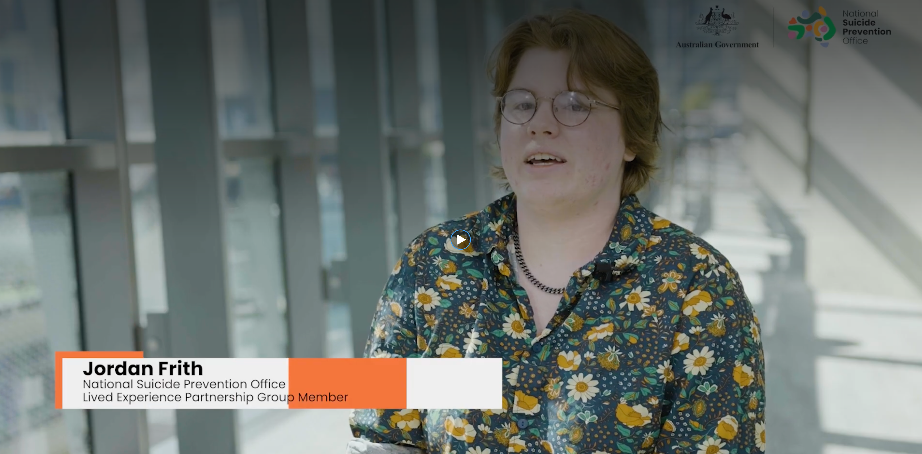

The Outcomes Framework

Slide 19
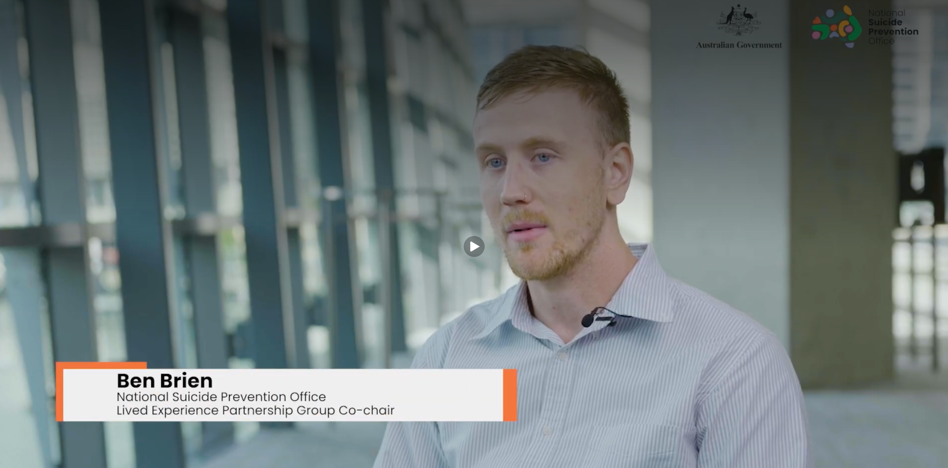

Community engagement

Slide 20

Lived experience

Slide 21

Approach to groups disproportionately impacted
While suicide impacts the whole population, it does not impact all groups of people equally. Information about the known disproportionate impacts on some specific population groups is summarised in the Strategy.
Disproportionately affected groups should not be defined by risk alone, as this overlooks their strengths and resilience. Higher rates of suicide are driven by social and economic inequities, including discrimination, stigma, economic insecurity, poorer health outcomes, and limited access to appropriate support. A broader approach to suicide prevention is needed that addresses both immediate support needs and the underlying drivers of distress. This approach would also better recognise intersectionality and support more flexible, responsive systems for people with diverse and overlapping experiences.
Suicide can affect anyone. However, suicide does not affect everyone in the same way. My experiences with suicide intersect with my disability, cultural diversity, gender, sexuality, homelessness, and more. To understand and support me, intersectionality is not just an option—it’s a necessity. My identities and experiences cannot be separated into silos or checkboxes. By embracing intersectionality, we recognise that a one-size-fits-all approach is inappropriate and dismissive of our identities. We need to see young people as whole people and co-produce suicide prevention supports that are truly holistic and inclusive.”
– Emily Unity
Participant, consultation with young people, July 2023

Slide 22
Approach to groups disproportionately impacted

Slide 23
The National Suicide Prevention Strategy Model
Domains
Prevention
of suicidal distress
Support
for people experiencing suicidal thoughts and behaviours
and those who care for them
Key objectives
Safety and security
Good health
Economic security
Social inclusion
Navigating life transitions
Culture of compassion
Accessibility
System-level coordination
Holistic approaches
Increased connection
Domain
Critical enablers
Key objectives
Improved governance
Embedded lived experience
Available and translated evidence
Capable and integrated workforce
https://www.mentalhealthcommission.gov.au/sites/default/files/2025-02/the-national-suicide-prevention-strategy.pdf

Slide 24
The National Suicide Prevention Strategy Model

Slide 25

Strategy Model discussion
The National Suicide Prevention
Group activity!
Instructions:
Split into groups of four.
In your group, choose one
of the key objectives.
Together, discuss what the objective means to you, what feels most relevant in your community, and any ideas or reflections that come up.
You will have 10 minutes to discuss as a group.
At the end, each group will briefly explain why they chose that objective and share a short summary of the discussion.
Domains
Prevention
of suicidal distress
Support
for people experiencing suicidal
thoughts and behaviours and those who
care for them
Key objectives
Safety and security
Good health
Economic security
Social inclusion
Navigating life transitions
Culture of compassion
Accessibility
System-level coordination
Holistic approaches
Increased connection
Domain
Critical enablers
Key objectives
Improved governance
Embedded lived experience
Available and translated evidence
Capable and integrated workforce

Slide 26
Suicide Prevention Goals and Outcomes

Slide 27
Prevention domain
Prevention
of suicidal distress
Suicidal distress is often related to the impact of the social, cultural, economic, legal and physical environments in which people live, work, learn and play (outlined in Figure 1). This Strategy focuses on five of these key social determinants: safety; good health; economic security; social inclusion; and the ability to navigate key life transitions.
These warrant particular attention because of their potential to both positively influence wellbeing and negatively impact on a person and contribute to suicidal distress. This Strategy approaches these factors from both perspectives.
Safety and security
Good health
Economic security
Social inclusion
Navigating life transitions
A comprehensive approach to suicide prevention must do more than support people who are experiencing suicidal distress—it must also reduce the likelihood of people experiencing suicidal distress in the first place.

Slide 28

Prevention – Safety and security
Prevention
of suicidal distress
What does safety and security mean?
What is already in place for safety and security locally?
What could be done to progress towards the outcome?
Safety and security
Good health
Economic security
Social inclusion
Navigating life transitions
Objective aim (from the Strategy)
What do we need to achieve?
People experience enhanced wellbeing through increased sense of safety and security. The prevalence and impacts of risks to personal safety and security
are diminished.
Outcome from Outcomes Map
People are safe and have a sense of security and stability in their lives

Slide 29
Prevention – Good health
Prevention
of suicidal distress
What does good health mean?
What is already in place for good health locally?
What could be done to progress towards the outcome?
Safety and security
Good health
Economic security
Social inclusion
Navigating life transitions
Objective aim (from the Strategy)
What do we need to achieve?
People experience enhanced wellbeing through improved health outcomes. The prevalence and impact of major preventable health risks associated with suicide are reduced.
Outcome from Outcomes Map
People experience good health enabling them to live their life with choice, purpose, meaning and satisfaction

Slide 30
Prevention – Economic security
Prevention
of suicidal distress
What does economic security mean?
What is already in place for economic security locally?
What could be done to progress towards the outcome?
Safety and security
Good health
Economic security
Social inclusion
Navigating life transitions
Objective aim (from the Strategy)
What do we need to achieve?
People experience enhanced wellbeing through increased economic security. The prevalence and impacts of economic insecurity are reduced.
Outcome from Outcomes Map
People have the financial and economic security to participate in activities that are meaningful to them

Slide 31
Prevention – Social inclusion
Prevention
of suicidal distress
What does social inclusion mean?
What is already in place for social inclusion locally?
What could be done to progress towards the outcome?
Safety and security
Good health
Economic security
Social inclusion
Navigating life transitions
Objective aim (from the Strategy)
What do we need to achieve?
People experience enhanced wellbeing through greater community inclusion and social connection. The prevalence and impact of loneliness and social exclusion are reduced.
Outcome from Outcomes Map
People are respected and valued for who they are and have a sense of belonging from their connections with other people

Slide 32
Prevention – Navigating life transitions
Prevention
of suicidal distress
What does
navigating life transitions mean?
What is already in place for navigating life transitions locally?
What could be done to progress towards the outcome?
Safety and security
Good health
Economic security
Social inclusion
Navigating life transitions
Objective aim (from the Strategy)
What do we need to achieve?
People experience enhanced wellbeing because they are equipped to navigate key stages of life and can work through disruptive transitions.
Outcome from Outcomes Map
People can navigate life transitions with agency and hope for their future

Slide 33
Prevention – Community capacity
Prevention
of suicidal distress
What does community capacity to address social determinants mean?
What community capacity already exists locally?
What could be done to progress towards the outcome?
Safety and security
Good health
Economic security
Social inclusion
Navigating life transitions
Outcome from Outcomes Map
Communities have the capacity to address the social determinants of suicide and protect agains suicide
The Outcomes Map includes an outcome for each key objective in the Strategy, as well as two additional outcomes across the Prevention and Support domains. In the Prevention domain, the additional outcome is about how prepared and able a community is to take action to prevent suicidal distress.
These outcomes have been added to enable measurement not only at an individual level, but also in the context of impacts for the broader community, family, carers and kin, who are central to effective suicide prevention.

Slide 34
Support
Support
for people experiencing suicidal thoughts and behaviours
and those who care for them
Culture of compassion
Accessibility
System-level coordination
Holistic approaches
Increased connection
Compassionate, timely, appropriate and coordinated support that addressed the drivers of a person’s distress is central to preventing suicidal distress from continuing or escalating. Support relates not only to responses from formal health and mental health services, but broader settings inclusive of community and other service touchpoints. This Strategy recognises that managing socio-economic factors is not just important in preventing suicidal distress, but in supporting those who experience suicidality.

Slide 35

Support – Culture of compassion
Support
for people experiencing suicidal thoughts and behaviours
and those who care for them
What does a
culture of compassion mean?
What compassionate support is already in place locally?
What could be done to progress towards the outcome?
Culture of compassion
Accessibility
System-level coordination
Holistic approaches
Increased connection
Objective aim (from the Strategy)
What do we need to achieve?
People impacted by suicidal thoughts and behaviours experience a compassionate response that helps them feel understood and empowered by the support system and society.
Outcome from Outcomes Map
People are supported with compassion and respect and experience support networks that partner with them in making decisions

Slide 36
Support - Accessibility
Support
for people experiencing suicidal thoughts and behaviours
and those who care for them
What does accessibility mean?
What accessible support is already in place locally?
What could be done to progress towards the outcome?
Culture of compassion
Accessibility
System-level coordination
Holistic approaches
Increased connection
Objective aim (from the Strategy)
What do we need to achieve?
People impacted by suicidal thoughts and behaviours can access timely and appropriate support to suit their needs.
Outcome from Outcomes Map
People can access appropriate supports when and how they need to

Slide 37
Support – System-level coordination
Support
for people experiencing suicidal thoughts and behaviours
and those who care for them
What does
system-level coordination mean?
What system-level coordination is already in place locally?
What could be done to progress towards the outcome?
Culture of compassion
Accessibility
System-level coordination
Holistic approaches
Increased connection
Objective aim (from the Strategy)
What do we need to achieve?
People impacted by suicidal thoughts and behaviours experience a seamless support system that facilitates access to appropriate supports.
Outcome from Outcomes Map
People experience support networks that work together seamlessly to keep
them well

Slide 38
Support – Holistic approaches
Support
for people experiencing suicidal thoughts and behaviours
and those who care for them
What does a
holistic approach mean?
What holistic support approaches are already in place locally?
What could be done to progress towards the outcome?
Culture of compassion
Accessibility
System-level coordination
Holistic approaches
Increased connection
Objective aim (from the Strategy)
What do we need to achieve?
People impacted by suicidal thoughts and behaviours receive holistic support that meets their needs, helping to reduce immediate distress and address the fundamental drivers of their distress.
Outcome from Outcomes Map
People experience supports that work with them to address the reasons for
their distress

Slide 39
Support – Increased connection
Support
for people experiencing suicidal thoughts and behaviours
and those who care for them
What does
increased connection mean?
What opportunities are already in place locally to support increased connection?
What could be done to progress towards the outcome?
Culture of compassion
Accessibility
System-level coordination
Holistic approaches
Increased connection
Objective aim (from the Strategy)
What do we need to achieve?
People who have experienced suicidal thoughts and behaviours feel increased wellbeing through enhanced connection to supports, social networks, community and culture. Families, carers and kin are empowered in their caring role and experience increased wellbeing by being supported through the impacts of their caring role.
Outcome from Outcomes Map
People are supported to connect with people who matter to them and who are integral to their wellbeing

Slide 40
Support – Family, carers and kin
Support
for people experiencing suicidal thoughts and behaviours
and those who care for them
What does
support for families, carers and kin mean?
What support is available locally for families, carers and kin?
What could be done to progress towards the outcome?
Culture of compassion
Accessibility
System-level coordination
Holistic approaches
Increased connection
Outcome from Outcomes Map
Families, carers and kin experience supports that address their needs and empower them to care for people experiencing suicidal distress
In the Support domain, an additional outcome makes sure family, carers and kin have what they need to support people experiencing suicidal distress and are well supported themselves.
This outcome has been added to enable measurement not only at an individual level, but also in the context of impacts on family, carers and kin, who are central to effective suicide prevention.

Slide 41
Critical enablers
Critical enablers
Improved governance
Embedded lived experience
Available and translated evidence
Capable and integrated workforce
The critical enablers describe the governance, lived and living experience involvement, data and evidence shifts, and workforce that are needed to implement and sustain the more coordinated, better-quality and more effective suicide prevention system outlined in earlier sections. The critical enablers provide the mechanism for continuous improvement of the suicide prevention system, and therefore should not be considered short-term, but rather enduring activities. The critical enablers have been structured around four main areas of system reform, but in practice they are mutually reinforcing and have many crossovers. For this reason, the critical enablers should be read as a group of actions to be implemented together.

Slide 42

Critical enablers – Improved governance
Critical enablers
What does improved governance look like?
How would improved governance impact local communities?
What could be done to progress towards the outcome?
Improved governance
Embedded lived experience
Available and translated evidence
Capable and integrated workforce
Objective aim (from the Strategy)
What do we need to achieve?
Suicide prevention in Australia has clear accountability and coordination of efforts across portfolios and between levels of government.
Outcome from Outcomes Map
Governments fulfil their responsibilities in preventing suicide and demonstrate accountability and collaboration

Slide 43
Critical enablers – Embedded lived experience
Critical enablers
What does embedding lived experience look like?
How would embedding lived experience impact local communities?
What could be done to progress towards the outcome?
Improved governance
Embedded lived experience
Available and translated evidence
Capable and integrated workforce
Objective aim (from the Strategy)
What do we need to achieve?
Suicide prevention in Australia has consistent and meaningful involvement of people with a lived and living experience of suicide in the design and delivery of high-quality and effective suicide prevention activities.
Outcome from Outcomes Map
People with lived and living experience of suicide are included as an integral part of the suicide prevention system and involved in shared decision making

Slide 44
Critical enablers – Available and translated evidence
Critical enablers
What does
available and translated evidence look like?
How would available and translated evidence impact local communities?
What could be done to progress towards the outcome?
Improved governance
Embedded lived experience
Available and translated evidence
Capable and integrated workforce
Objective aim (from the Strategy)
What do we need to achieve?
Suicide prevention in Australia uses fit-for-purpose evidence to guide timely, high-quality and effective suicide prevention activities.
Outcome from Outcomes Map
An evidence-based learning culture operates to continually improve the effectiveness of suicide prevention efforts

Slide 45
Critical enablers – Capable and integrated workforce
Critical enablers
What does
having a capable
and integrated workforce look like?
How would having a capable and integrated workforce impact local communities?
What could be done to progress towards the outcome?
Improved governance
Embedded lived experience
Available and translated evidence
Capable and integrated workforce
Objective aim (from the Strategy)
What do we need to achieve?
Suicide prevention in Australia is delivered by a capable, integrated and sustained workforce.
Outcome from Outcomes Map
The suicide prevention workforce has the capability and capacity to prevent and respond to suicide

Slide 46
Prioritisation discussion
Next steps | Who is responsible | Time frame

Slide 47
Reflections
Your presentation may be completed over several sessions to allow sufficient time to cover all content and objectives. Please consider a range of reflection activities at every session.
Add text here

Slide 48
Closing and self-care
Your presentation may be completed over several sessions to allow sufficient time to cover all content and objectives. Please ensure the self-care steps are repeated at every session.

Slide 49
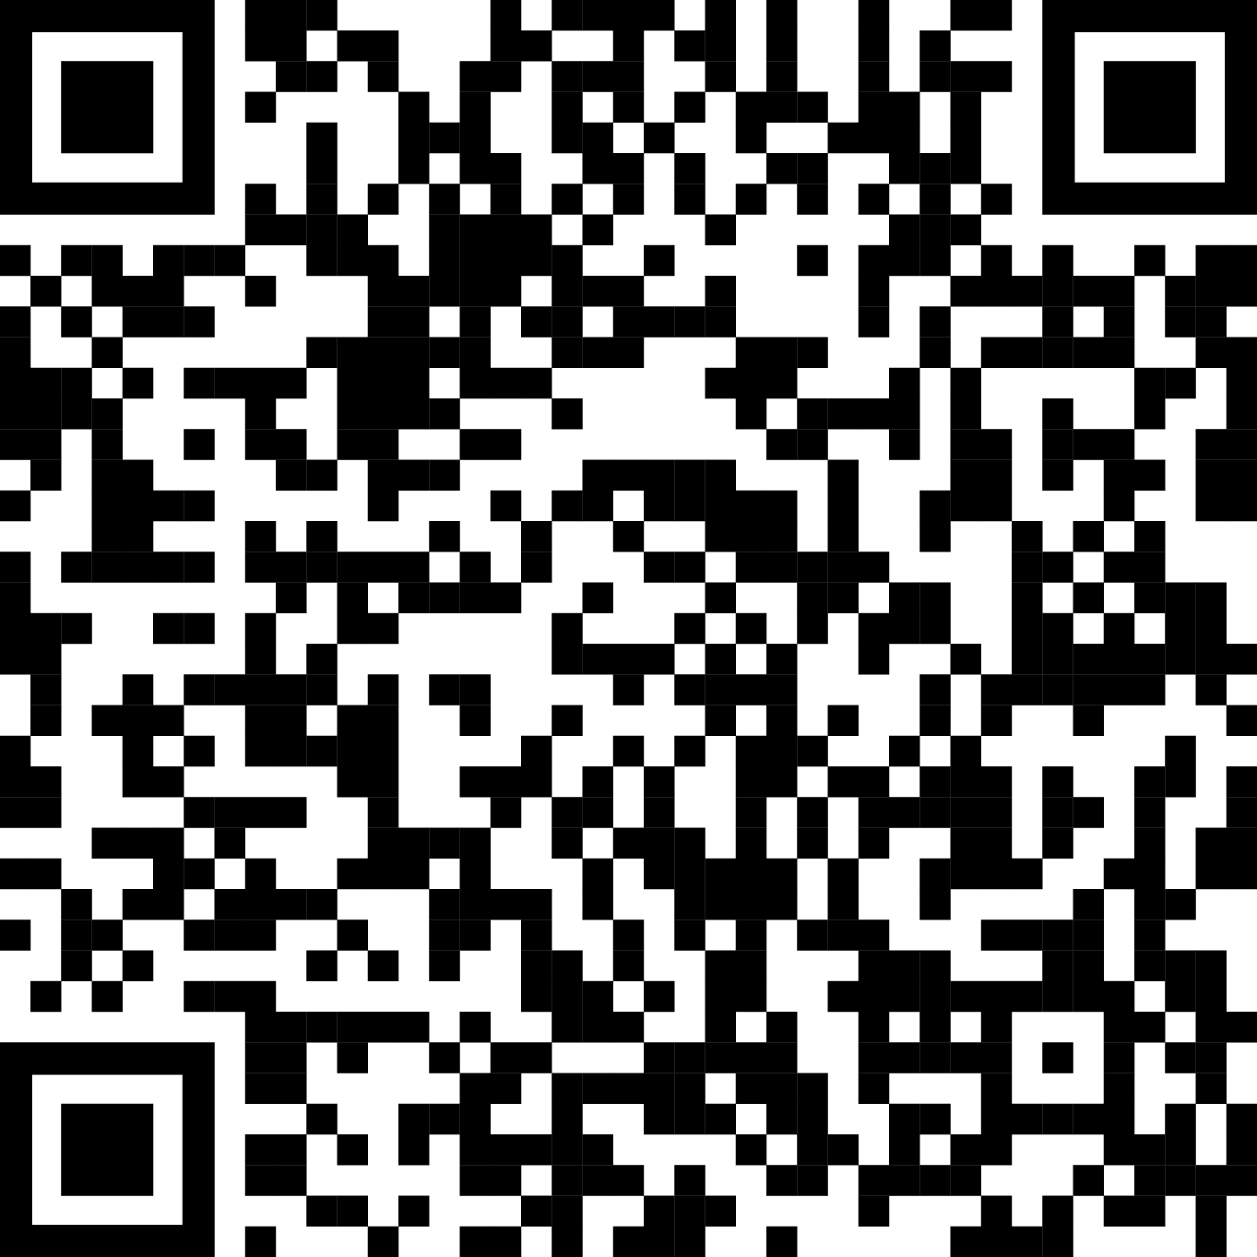
Getting involved in the work of the NSPO
Scan this QR code to register
your interest and be kept informed about the work of the National Suicide Prevention Office.
If you would like to provide feedback to the NSPO, you can email nspo@nspo.gov.au

